Slide 1
Music Generation Using LSTM Neural Network
Soumith Reddy CH
soumithr@buffalo.edu

Slide 2
Abstract
There are many fields where Neural Networks are showing commendable grown with impeccable results matching humans in performance. Some of them are Image Recognition, Speech recognition, speech to text conversion.
In this work I wanted explore Music Generation using Character based RNN. There are already many kinds of implementations about music generation, I want to explore one kind of music generation which is least explored by others and demonstrate my findings.

Slide 3
Introduction
The task here is to take some existing music data then train the model using this existing data. The model has to learn the patterns in music that we humans enjoy.
Once it learns these patterns, the model should be able to generate new music. It should not simply copy-paste from the training data instead it has to understand the patterns of music, to generate new music.
In this project I am taking single instrument music as input and generating a music of similar kind as output

Slide 4
Data
The data is taken from opensource MIT website. There are 1850 tunes which are in abc format
There are two parts in abc format. Part-1 represents meta data. Lines in the Part-1 of the tune notation, beginning with a letter followed by a colon, indicate various aspects of the tune such as the index, the title (T:), the time signature (M:), the default note length (L:), the type of tune (R:) and the key (K:). Part-2 represents the tune, which is a sequence of characters where each character represents some musical note.

Slide 5
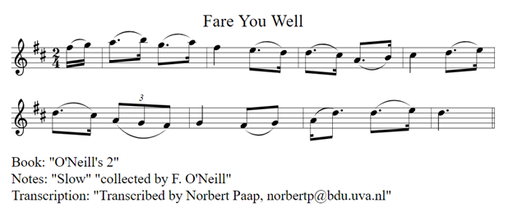
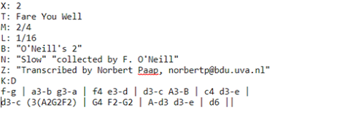
Text to Music Notes

Slide 6
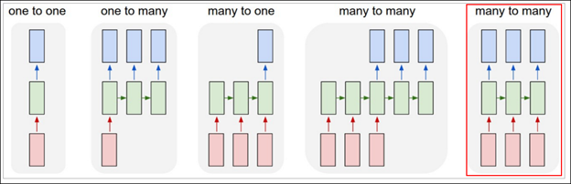
Background
I will be using CharRNN model which is a special type of RNN for the model. We will feed a sequence of characters to the model and the model should try to predict the next character in the sequence.
There are different variations of Char RNN like one-one ,one-many and many-many. We will be using many-many model where the model will try to predict output for each input value.

Slide 7
Model
We will feed batch of sequences at once into our RNN model.
Batch Size = 16 Sequence Length = 64
While creating batches we generate X and Y from the input data where X is a 2D vector with index of characters stored the same order as they are in the file. Y is a 3D vector where it stores the corresponding next character of each X in a one-hot encoded manner.
To generate one output for each input provided we use Return Sequences as ‘TRUE’ in the model definition.
We give stateful as True for LSTM model because we are using batches and we want output the one batch as input to the next batch.
Notes:
For batch 1 the initial input is Zero but for next batch the output of current batch is given as input , because we are creating our batches continuously we want to give output of current batch as input to the next batch.
This helps our model to learn long term dependencies and generate much better output sequence.

Slide 8
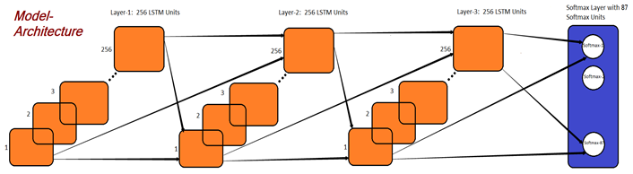
Model Architecture
We are using a sequential model, where we have a embedding layer first to embed the characters to vectors of size 512
We have three LSTM layers of size 256 as shown in the Fig.7 and for each LSTM layer we are adding a dropout with value of 0.2 to reduce overfitting. After the LSTM layers we are adding a Time Distributed dense layer and then Softmax activation layer.
Notes:
To generate one output for each input provided we use Return Sequences as ‘TRUE’ in the model definition.
We give stateful as True for LSTM model because we are using batches and we want output the one batch as input to the next batch.

Slide 9
Music Generation
We will give an input to the trained model it should generate the probabilities of each of the 87 characters and give the character with highest probability as the next character.
we ask the user to provide the first character as input to the model and the number of character length music he wants typically from 300-600.
The model will then generate music with the input character as first character and continuously generates characters till the length of the input given.

Slide 10
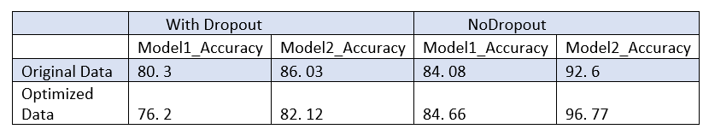
Results
Accuracy:
Accuracy in the model indicates how often the model is able to predict the correct next character given the current character.
We observe that Title(T), Book(B), Notes(N) and Transciption(Z) is not required to generate music and removing them from our tunes does not change our original tune. Hence, we are processing our data to remove those lines from all the 1850 tunes.
Notes:
The model can start with a completely random character given by the user and starts generating next characters continuously until it reaches new lines which in our training data represents as ending of a tune.

Slide 11
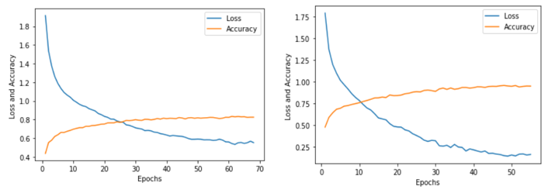
Overfitting
I have removed the dropouts from the model and the accuracy started increasing. I have implemented the same model to both the initial data and the preprocessed data and compared the accuracy in all different scenarios.
The variation of accuracy and loss with each epoch can be seen by plotting loss and accuracy with epochs. The model is overfitting as clearly seen from below Fig, its accuracy is too high, and loss is near to zero in the right plot which clearly shows overfitting.
We should have a trade-off between accuracy and originality of music such that the music generated should be able to generate smooth music and not overfit.

Slide 12
Generated Music

Slide 13
Conclusion and Future Works
From my observations I can conclude that with an accuracy of 80-85% we can generate new music by learning patterns between musical notes. The music generated with this accuracy is original and is as melodious as the original tunes without any discontinuities.
Modified output such that the tune generated to start in a professional way which is a common hurdle in previous models.
I have used only one type of music as training data and generated similar kind of music, we can try training different instruments and generate different tunes.
We can also try different data augmentation in case the dataset is small and try generating music.
There is scope for more research, to find out the best accuracy for a model such that it is not overfitting and generating fresh tunes.
Notes:
There are limitations such as tunes and availability of tunes in abc format because of which the tunes are not of professional quality, if we can get abc formats of some of the famous and latest tunes we can make better contemporary music.
I tried implementing the project original way without any libraries/toolkits but currently there are python toolkits like Music21 which can be of great help.
With more knowledge on music formats and different kinds of starting tones of music we can limit the model to take only specific characters as inputs rather than taking all unique characters as inputs.

Slide 14
THANK YOU

